Slide 1
Information-Theoretic Measures of Metacognition
Dr. Sascha Meyen (sascha.meyen@uni-tuebingen.de)
March 6, 2024
Neural Information Processing Retreat (Prof. Wichmann)
University of Tübingen
Notes:
I want to show you two cases in which information theory helps to properly interpret research results, and I bet it helps even in your research.

Slide 2


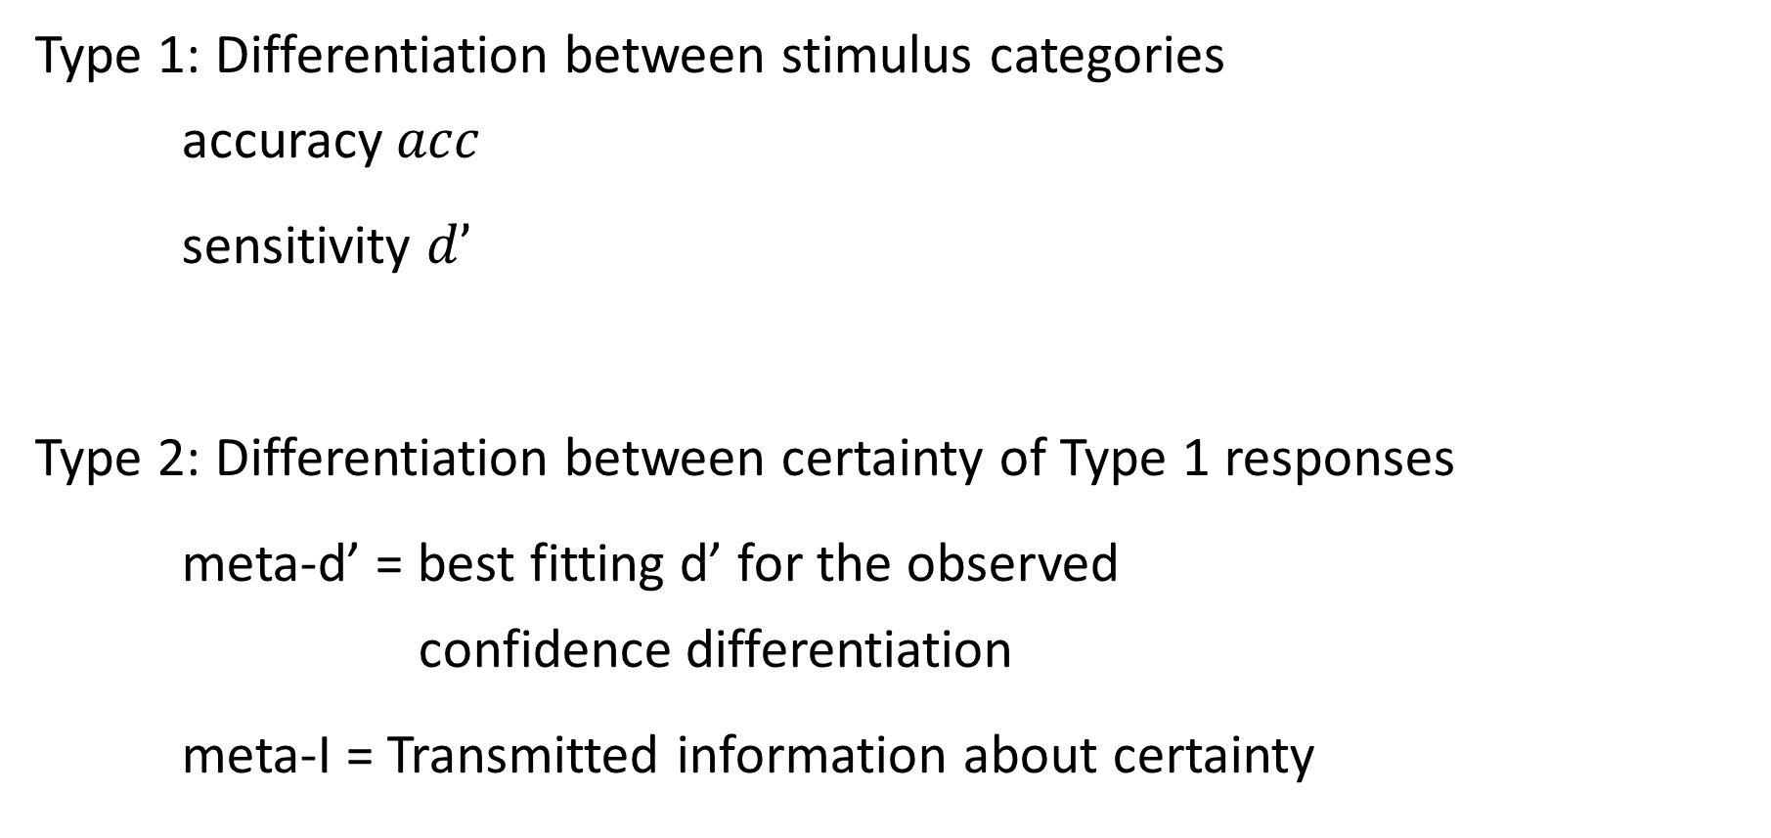
Type 1 vs. Type 2 performance
Type 1: Differentiation between stimulus categories accuracy $acc$
sensitivity $d’$
Type 2: Differentiation between certainty of Type 1 responses
meta-d’ = best fitting d’ for the observed confidence differentiation
meta-I = Transmitted information about certainty
Type 1 response:
“It’s stimulus category A.”
Type 2 response: “I am certain.”
Katyal & Fleming, 2023; Shekhar & Rahnev , 2022; Maniscalco & Lau, 2012, Fleming & Lau, 2014

Slide 3
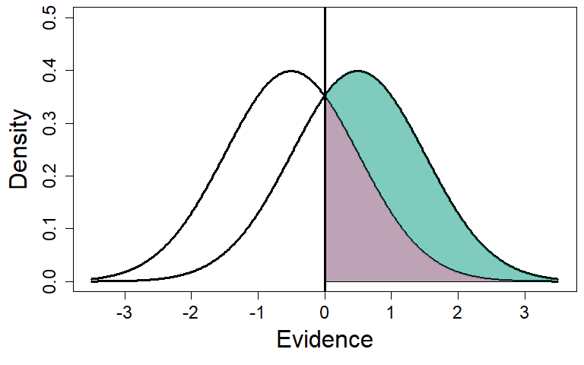
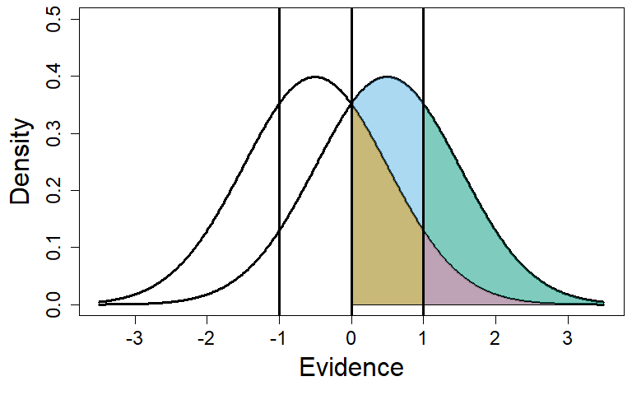
Meta-sensitivity (meta-d‘) in theory
d‘ = 1
meta-d‘ = 1
 | R = -1 | R = +1
Y = +1 | .15 | .35
Y = -1 | .35 | .15
 | -1, high | -1, low | +1, low | +1, high
Y = +1 | .03 | .12 | .19 | .15
Y = -1 | .15 | .19 | .12 | .03

Slide 4
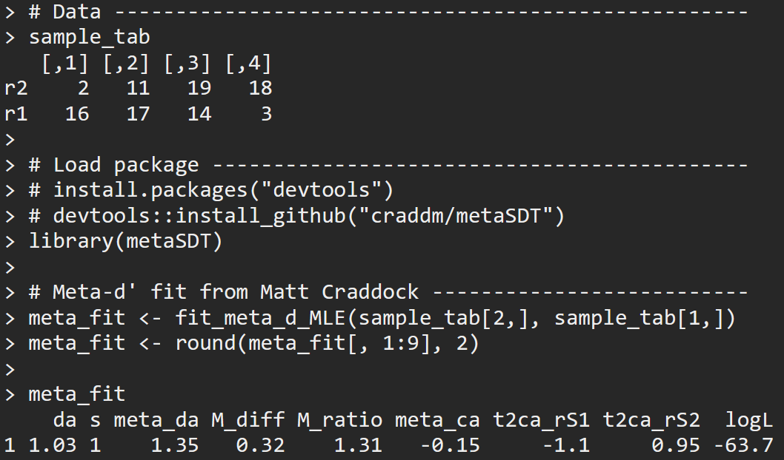
Meta-sensitivity (meta-d‘) with simulated data
d‘ = 1
meta-d‘ = 1
 | R = -1 | R = +1
Y = +1 | .15 | .35
Y = -1 | .35 | .15
 | -1, high | -1, low | +1, low | +1, high
Y = +1 | .03 | .12 | .19 | .15
Y = -1 | .15 | .19 | .12 | .03
Fit

Slide 5
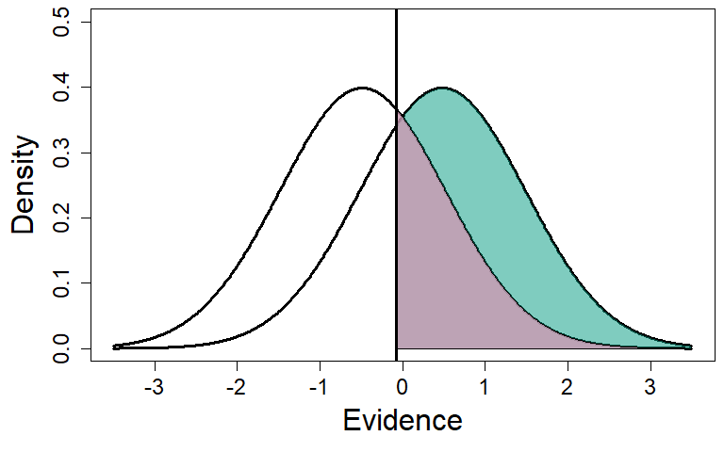
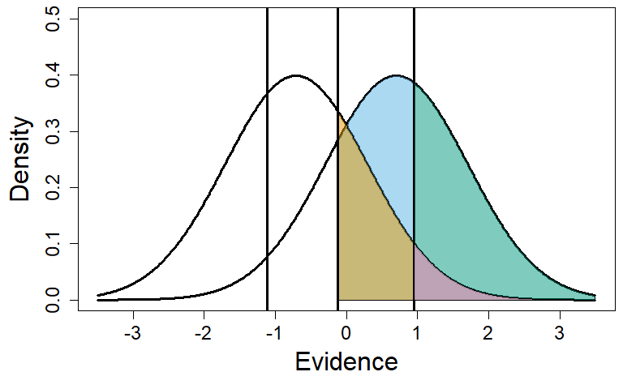
Meta-sensitivity (meta-d‘) with simulated data
fitted d‘ = 1
fitted meta-d‘ = 1.3
Fit
n=100 | R = -1 | R = +1
Y = +1 | 13 | 37
Y = -1 | 33 | 17
n=100 | -1, high | -1, low | +1, low | +1, high
Y = +1 | 02 | 11 | 19 | 18
Y = -1 | 16 | 17 | 14 | 03
Data

Slide 6


Meta-sensitivity (meta-d‘) with simulated data
fitted d‘ = 1
fitted meta-d‘ = 1.3
 | R = -1 | R = +1
Y = +1 | .13 | .37
Y = -1 | .33 | .17
 | -1, high | -1, low | +1, low | +1, high
Y = +1 | .02 | .08 | .20 | .20
Y = -1 | .17 | .19 | .12 | .02
Fit
n=100 | R = -1 | R = +1
Y = +1 | 13 | 37
Y = -1 | 33 | 17
n=100 | -1, high | -1, low | +1, low | +1, high
Y = +1 | 02 | 11 | 19 | 18
Y = -1 | 16 | 17 | 14 | 03
Data

Slide 7
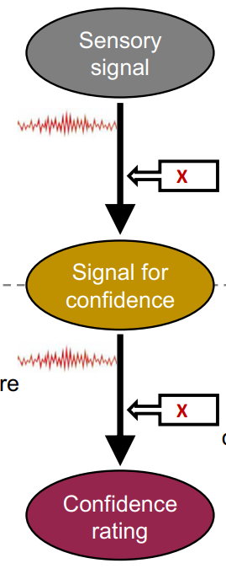
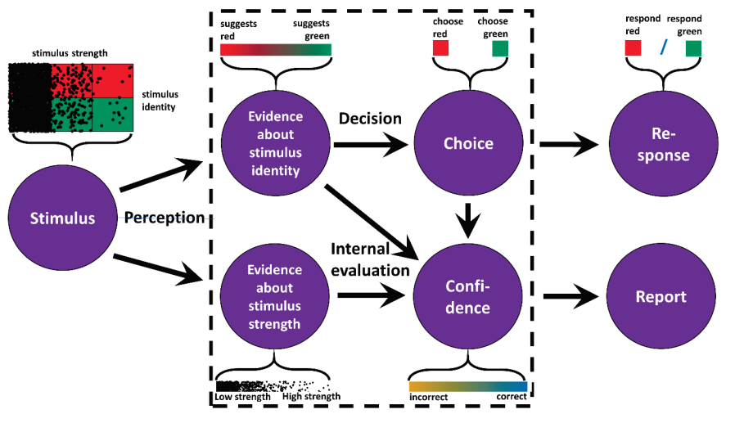
Model for metacognitive inefficiency meta-d’ < d’
Model for metacognitive hyper-efficiency meta-d’ > d’
(Shekhar & Rahnev, 2021, TiCS)
(Rausch et al., 2019, PLoS CB)

Slide 8
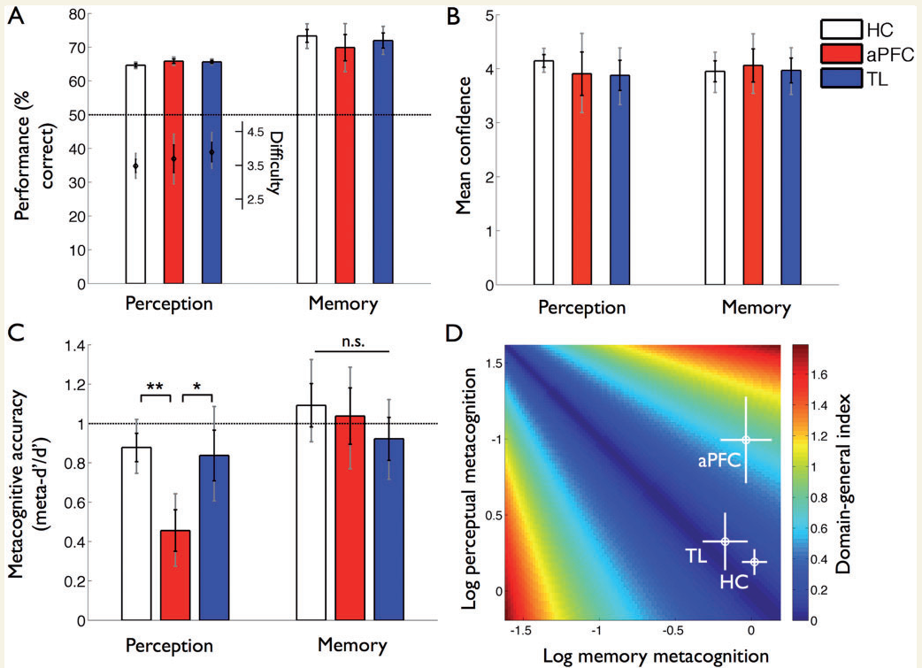
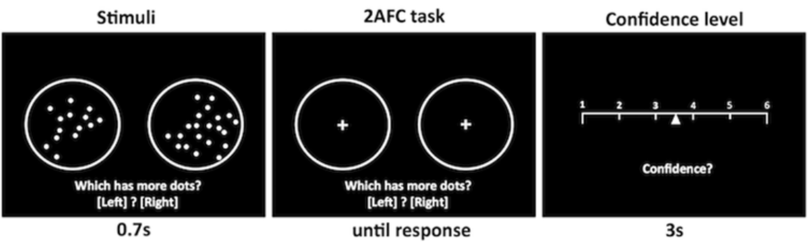
Example clinical study with meta-d’ ≠ d’
Patients with aPFC lesion vs health controls in in perceptual tasks:
Type 1 performance unaffected
Type 2 performance impaired
Fleming et al. (2014)

Slide 9
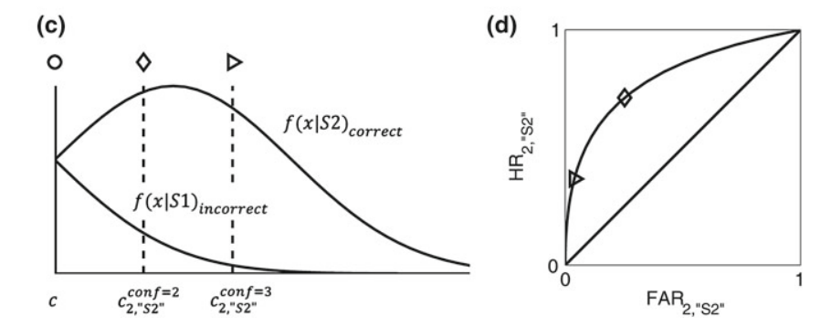
Overview of other measures
M-Ratio = meta-d’/d’
Type 2 d’
Type 2 ROC Analysis
Correlations
Model based approaches
 | low conf. | high conf.
correct | .15 | .35
incorrect | .35 | .15
Maniscalco & Lau (2012, 2014), Fleming & Lau (2014), Guggenmos (2022)

Slide 10
Practical part 1
Simulate data and evaluate meta-d’:
For a given accuracy, what is the lowest / highest meta-d’?
Code and data at: saschameyen.com/NIP/

Slide 11
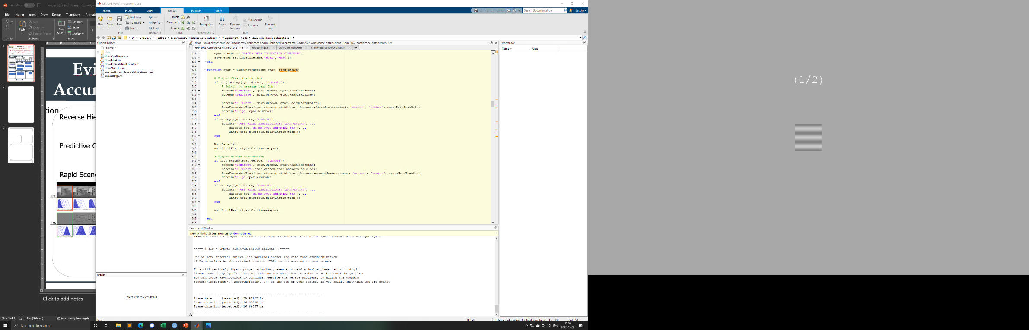

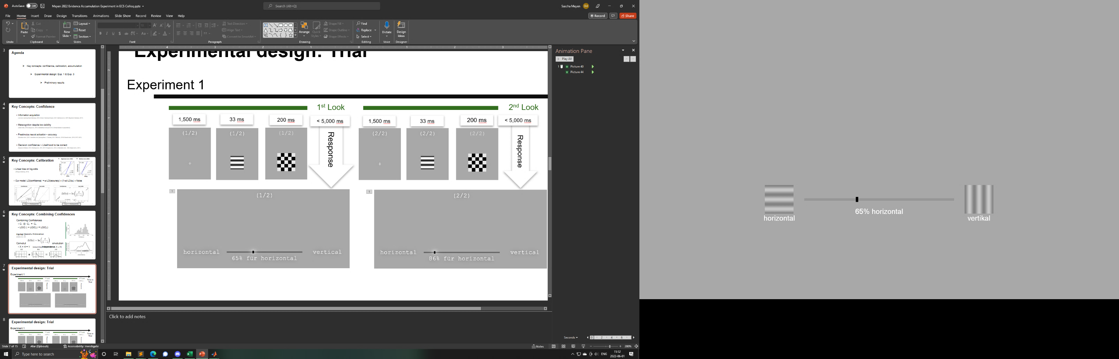
Practical Part
Code and data at: saschameyen.com/NIP/
Simulate data and evaluate meta-d’: For a given accuracy, what is the lowest / highest meta-d’?
If you are more interested in real data: evaluate our experiment.
Stimulus
Mask
Response
(1, 2, 3, 4, or 6 frames at 120 Hz)
(500 ms)
(less than 5 s)

Slide 12
Best- and worst Type 2 performances
Worst case
Best case
 | -1! | -1? | +1? | +1!
Y = +1 | .075 | .075 | .175 | .175
Y = -1 | .175 | .175 | .075 | .075
 | -1! | -1? | +1? | +1!
Y = +1 | 0 | .15 | .15 | .20
Y = -1 | .20 | .15 | .15 | 0

Slide 13
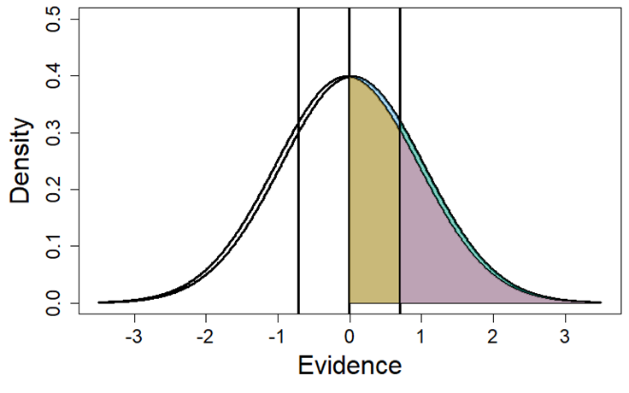
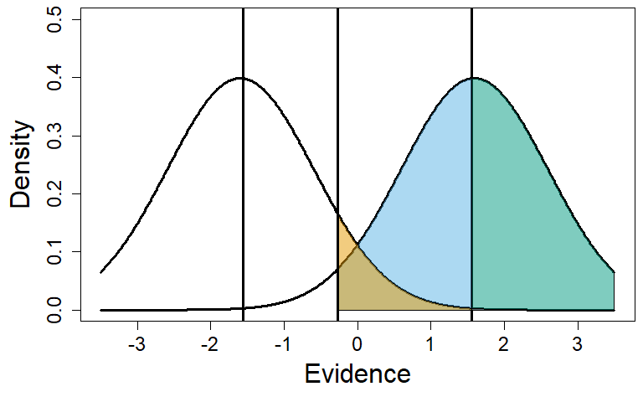
Meta-sensitivity (meta-d‘): worst vs. best case
fitted meta-d‘ = 0.1
fitted meta-d‘ = 3.3
 | -1, high | -1, low | +1, low | +1, high
Y = +1 | .11 | .13 | .13 | .13
Y = -1 | .12 | .13 | .13 | .11
 | -1, high | -1, low | +1, low | +1, high
Y = +1 | 0 | .02 | .23 | .26
Y = -1 | .26 | .20 | .05 | 0
Fit
n=100 | -1, high | -1, low | +1, low | +1, high
Y = +1 | 06 | 07 | 19 | 18
Y = -1 | 16 | 17 | 09 | 08
n=100 | -1, high | -1, low | +1, low | +1, high
Y = +1 | 0 | 13 | 17 | 20
Y = -1 | 20 | 13 | 17 | 00
Data

Slide 14
Best- and worst Type 2 performances
Worst case
Best case
 | -1! | -1? | +1? | +1!
Y = +1 | .075 | .075 | .175 | .175
Y = -1 | .175 | .175 | .075 | .075
 | -1! | -1? | +1? | +1!
Y = +1 | 0 | .15 | .15 | .20
Y = -1 | .20 | .15 | .15 | 0
Bad Type 1
Meta-d’ = 0
→ Meta-d’ = 4.1
(with n = 100)
→ Meta-d’ = 4.4
(with n = 200)
 | -1! | -1? | +1? | +1!
Y = +1 | .025 | .025 | .225 | .225
Y = -1 | .225 | .225 | .025 | .025
 | -1! | -1? | +1? | +1!
Y = +1 | 0 | .025 | .025 | .45
Y = -1 | .45 | .025 | .025 | 0
Good Type 1
Meta-d’ = 0
→ Meta-d’ = 4.6
(with n = 100)
→ Meta-d’ = 5
(with n = 200)

Slide 15
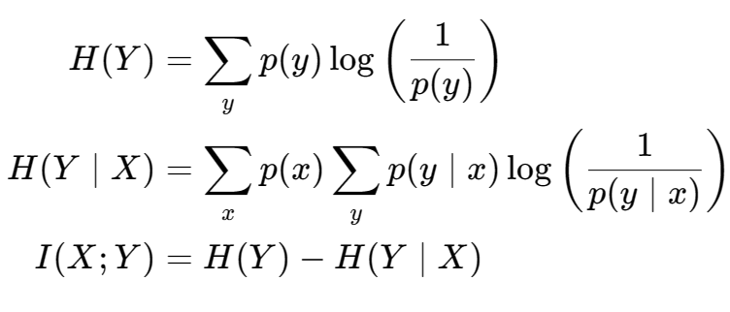
Classical Information Theory
Entropy
Conditional entropy
Transmitted Information
Why measure entropy this way?
- Additivity
- Continuity
- Maximum principle
- Non-negativity
MacKay (2003), Cover & Thomas (2006), Shannon (1948)
Notes:
\begin{align*}
H(Y) &= \sum_y p(y) \log\left(\frac{1}{p(y)}\right) \\
H(Y\mid X) &= \sum_{x} p(x) \sum_y p(y \mid x) \log\left(\frac{1}{p(y \mid x)}\right) \\
I(X; Y) &= H(Y) - H(Y \mid X)
\end{align*}

Slide 16
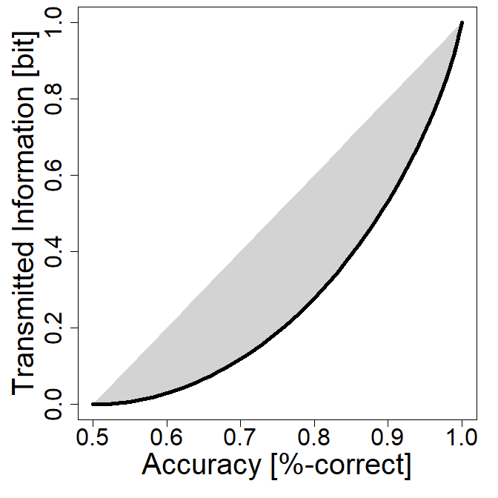


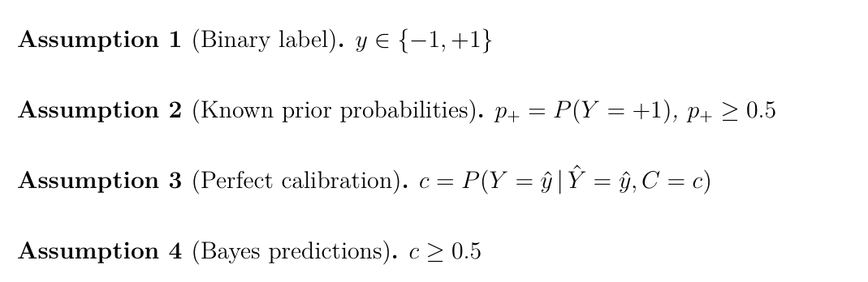


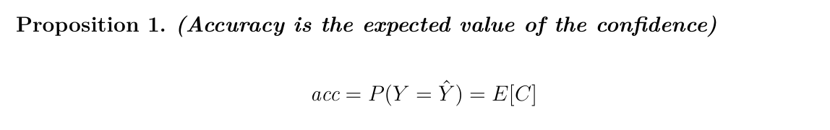
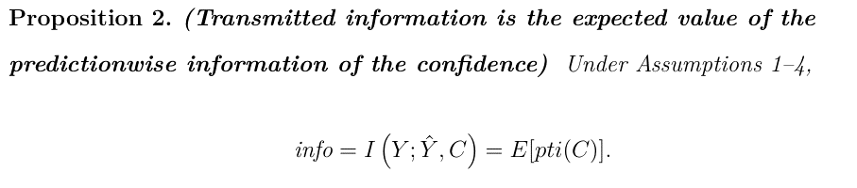

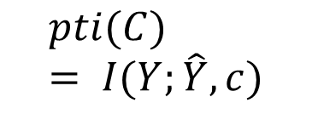

Setting and assumptions
$$pti(C) = I(Y;\hat{Y}, c)$$
Label
Response
 | -1, high | -1, low | +1, low | +1, high
Y = +1 | 02 | 11 | 19 | 18
Y = -1 | 16 | 17 | 14 | 03
m | .18 | .28 | .33 | .21
acc | .89 | .61 | .58 | .86
pti | .50 | .03 | .02 | .41
$$Y$$
$$\left(\hat{Y}, C\right)$$

Slide 17
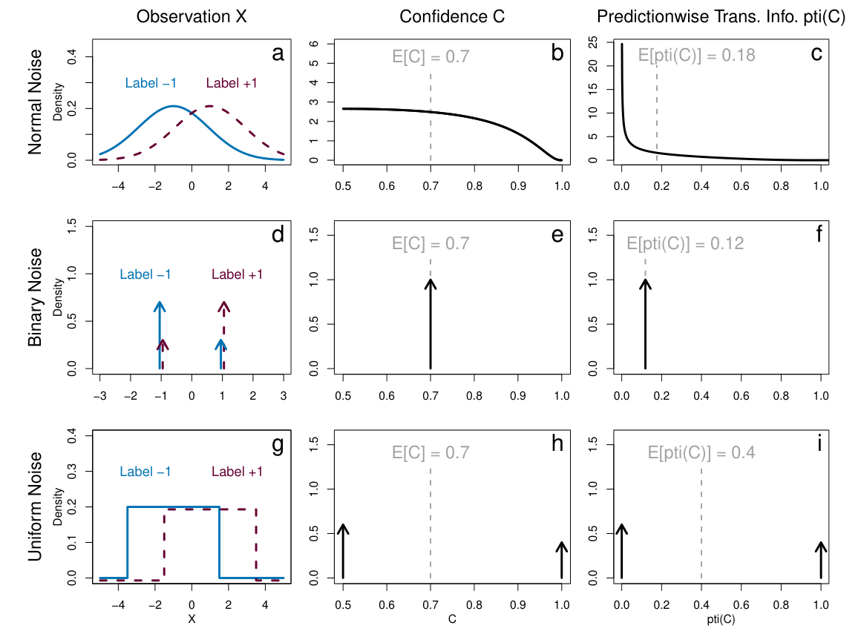
Accuracy-information ambiguity

Slide 18
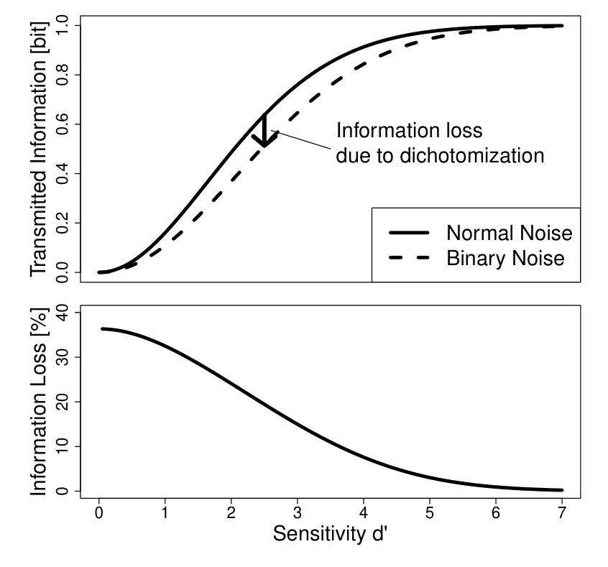
Cost of dichotomization
Relative information loss from dichotomizing normal data: about 1/3 for “small” effects.
Impact on statistical power: d’ = 1, n = 20 (continuous) → 90% d’ = 1, n = 30 (dichotomized) → 90%
(Cohen, 1983; MacCallum et al., 2022; Altman & Royston, 2006)

Slide 19
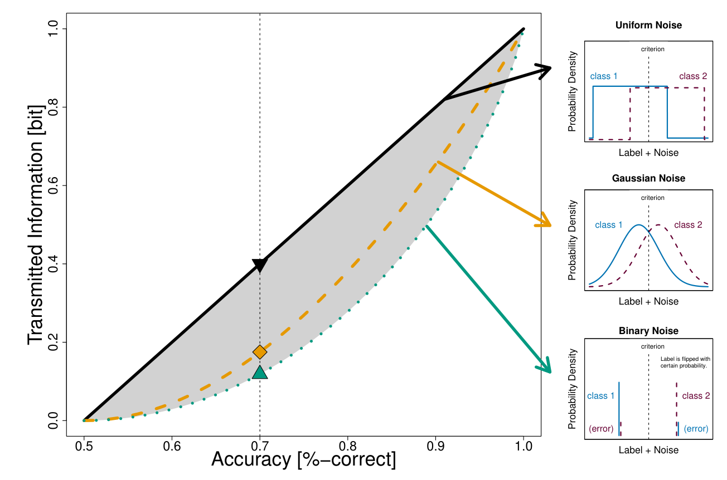
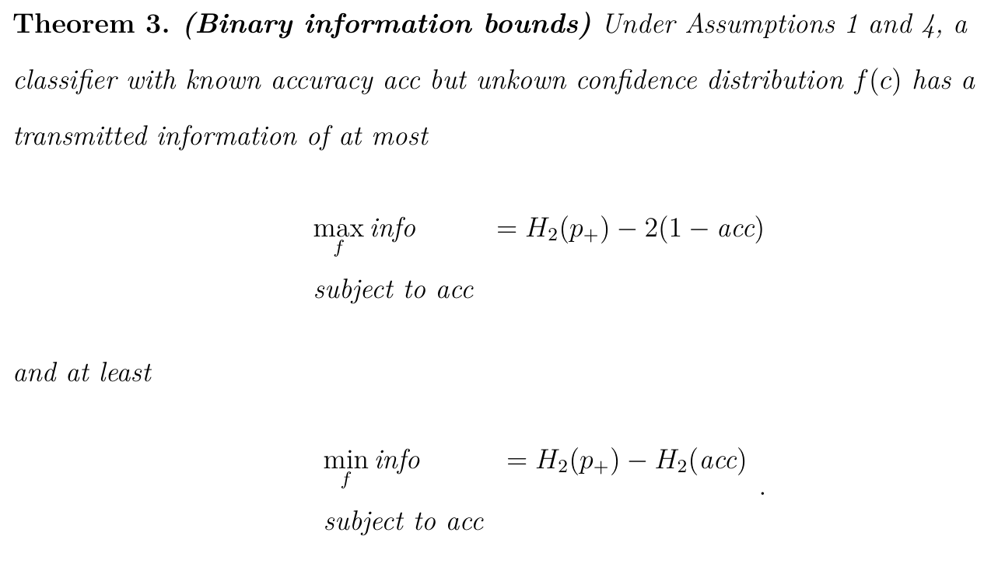
Transmitted information bounds

Slide 20
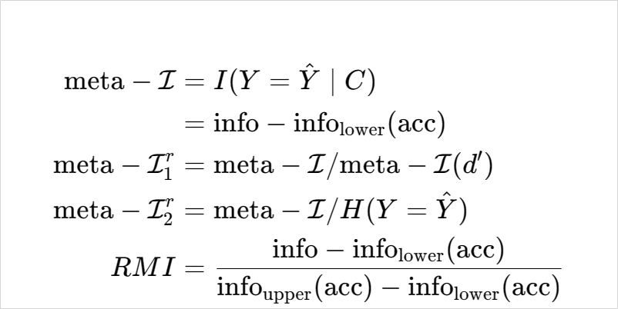
Information-theoretic meta-measures
Peter Dayan (2023)
Meyen (in preparation)

Slide 21
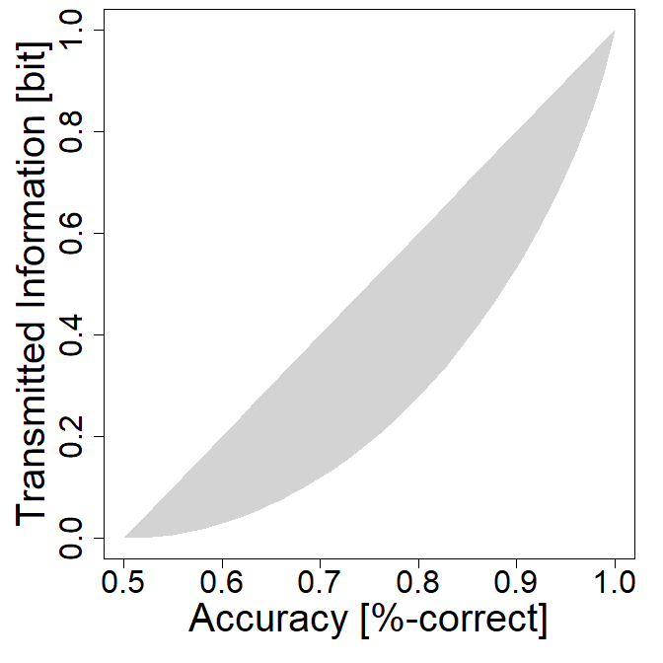
Information-theoretic meta-measures
Peter Dayan (2023)
Meyen (in preparation)
meta-I = 0.08 bit
 | -1, high | -1, low | +1, low | +1, high
Y = +1 | 02 | 11 | 19 | 18
Y = -1 | 16 | 17 | 14 | 03

Slide 22
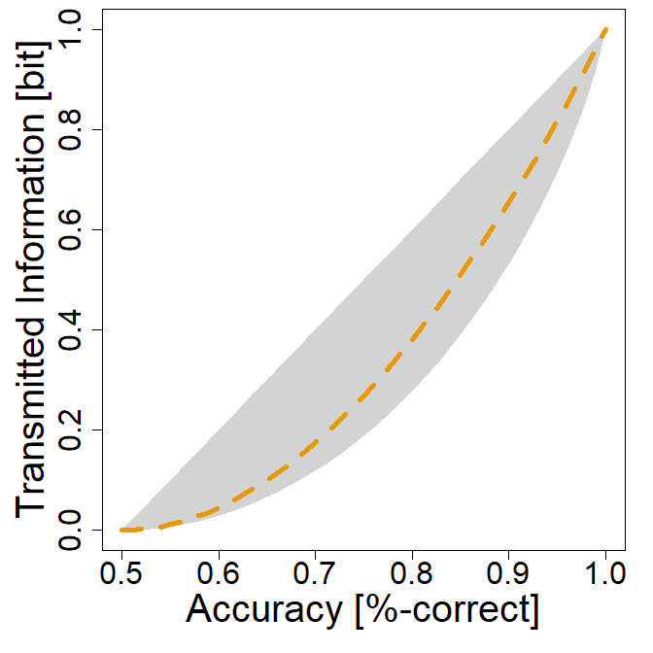
Information-theoretic meta-measures
Peter Dayan (2023)
Meyen (in preparation)
meta-I^{r}₁ = 1.5
 | -1, high | -1, low | +1, low | +1, high
Y = +1 | 02 | 11 | 19 | 18
Y = -1 | 16 | 17 | 14 | 03

Slide 23

Information-theoretic meta-measures
Peter Dayan (2023)
Meyen (in preparation)
meta-I^{r}₂ = 0.08
 | -1, high | -1, low | +1, low | +1, high
Y = +1 | 02 | 11 | 19 | 18
Y = -1 | 16 | 17 | 14 | 03

Slide 24
Information-theoretic meta-measures
Peter Dayan (2023)
Meyen (in preparation)
RMI = 0.29
 | -1, high | -1, low | +1, low | +1, high
Y = +1 | 02 | 11 | 19 | 18
Y = -1 | 16 | 17 | 14 | 03

Slide 25
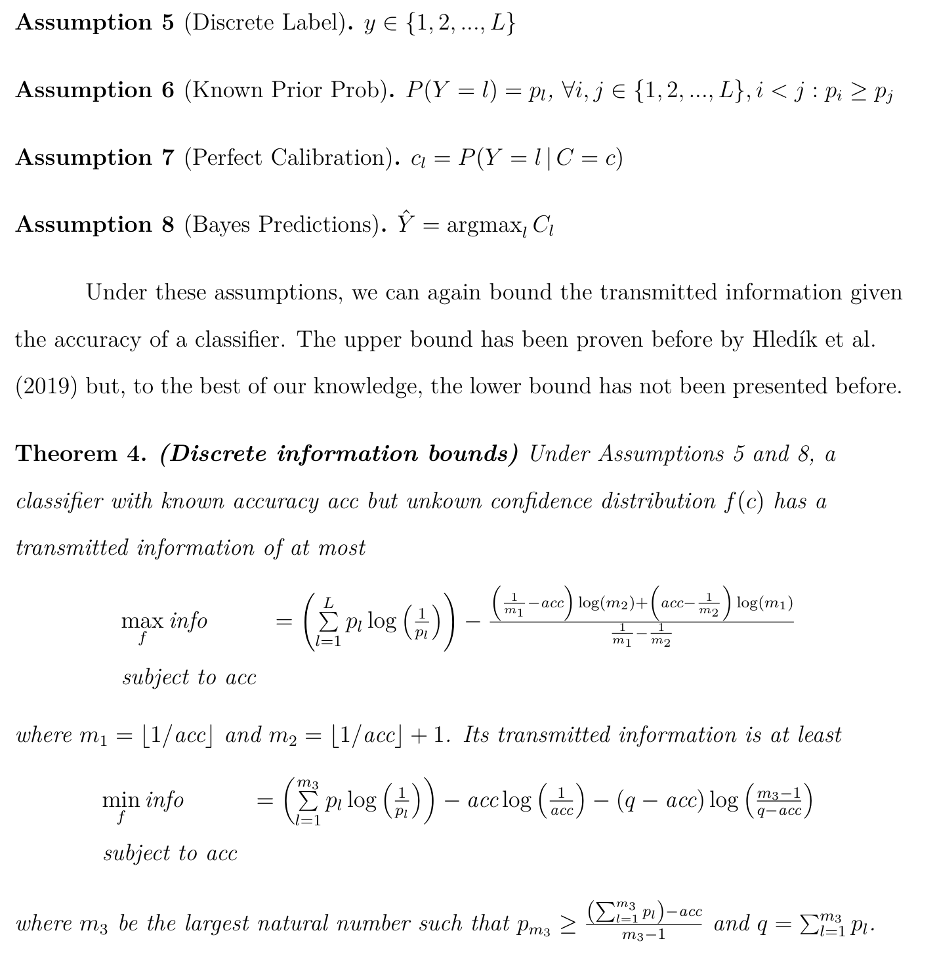
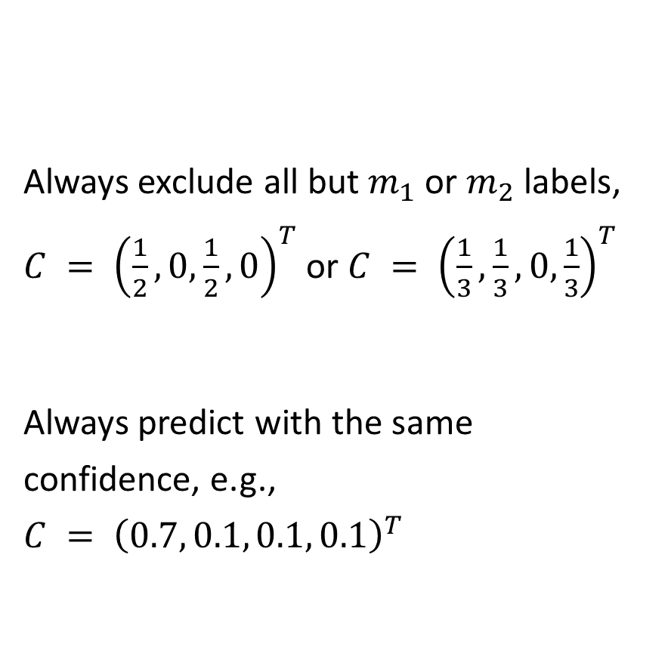
Transmitted Information Bounds, Generalized
Always exclude all but $m_{1}$ or $m_{2}$ labels, $C = {\left(\frac{1}{2}, 0, \frac{1}{2}, 0\right)}^{T}$ or $C = {\left(\frac{1}{3},\frac{1}{3},0, \frac{1}{3}\right)}^{T}$
Always predict with the same confidence, e.g., $C = {\left(0.7, 0.1, 0.1, 0.1\right)}^{T}$

Slide 26
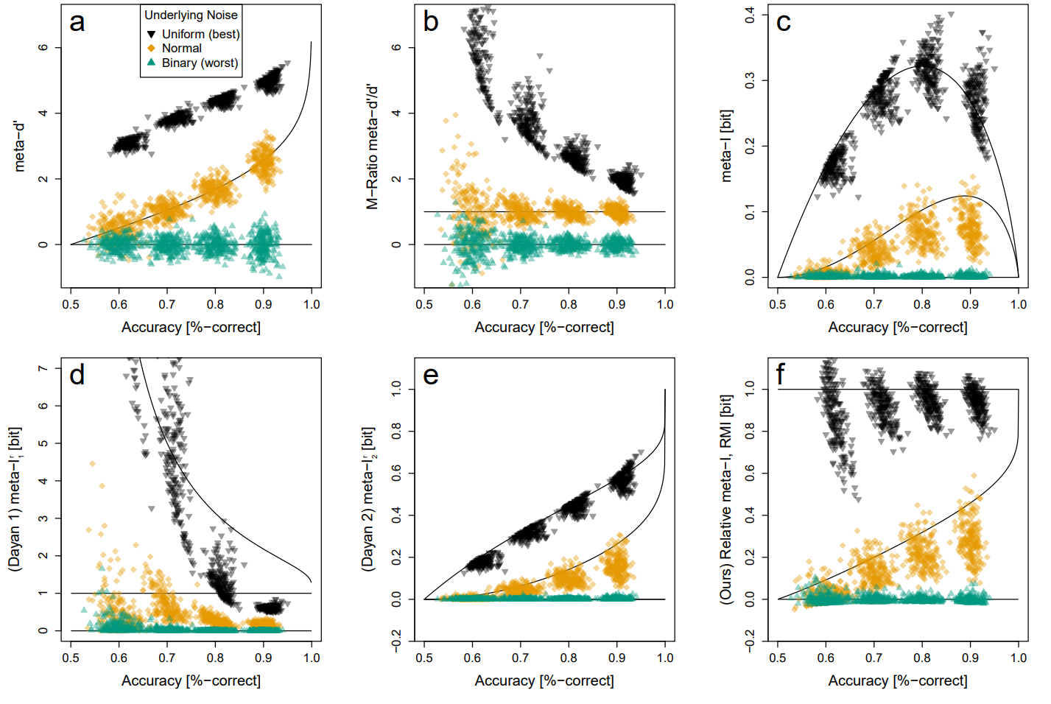
Type 1 vs 2 dependencies in meta-measures

Slide 27
Practical part 2
Simulate data and evaluate meta-d’:
For a given accuracy, what is the lowest / highest meta-d’?
Evaluate information-theoretic measures
Code and data at: saschameyen.com/NIP/

Slide 28
Discussion
Meta-d’ is susceptible to misspecification
Accuracy-information ambiguity
Surplus information as “metacognition”
Observer’s response-mapping is ignored
What is equal meta-I for different accuracies?
Increasing RMI for normal noise
Inherent Type 1 vs. Type 2 dependencies?
2
1
 | -1! | -1? | +1? | +1!
Y = +1 | .025 | .025 | 0 | .45
Y = -1 | .025 | .025 | .45 | 0

Slide 29
Practical Part
Code and data at: saschameyen.com/NIP/
Simulate data and evaluate meta-d’: For a given accuracy, what is the lowest / highest meta-d’?
If you are more interested in real data: evaluate our experiment.
Stimulus
Mask
Response
(1, 2, 3, 4, or 6 frames at 120 Hz)
(500 ms)
(less than 5 s)

